Slide 1
Linear and Circular Races AND Boats & Streams

Slide 2

Linear and Circular Races
Introduction
Problems with races on linear tracks: head start and dead heat finish, head start and early finish, head start and late finish
Problems on circular track: first meeting point, meeting at starting point and number of meetings
Data Sufficiency

Slide 3

LINEAR RACES
Commonly used expressions in linear races
Expression | Meaning
Head-Start / A gives B start of x meters | When a racer gets a start x meters ahead of the starting point it’s called head-start of x meters. Here A gives B a head-start of x meters.
Head-Start/ A can give B a start of t minutes | When a contestant gets a start by t seconds earlier than other ones, it’s called head-start of t seconds. Here A gives B a head-start of t seconds.
A beats B by x meters | When A reaches the winning point before B and is x meters away from B. Then A beats B by x meters.
A beats B by t seconds | When A reaches the winning point t seconds before B. Then A beats B by t meters.
Dead Heat | A dead heat is a situation of tie. When all the participants reach the winning point at the same point.

Slide 4
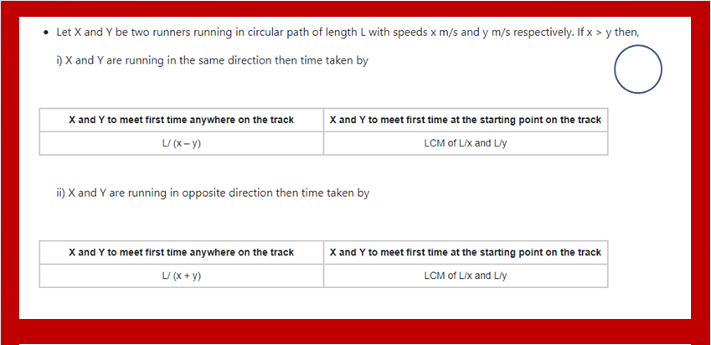
CIRCULAR RACE CONCEPT

Slide 5
1. In a race of 1500m, H beats Q by 195 m or 15 seconds. Find Q’s speed
A. 5 B. 10 C. 13 D. 20
Notes:
Difficulty Level : Easy (compulsory)
C

Slide 6
2. In a 400 m race, A can give B 30 m and C 50 m start . In the same race B can give to C a start of(approx)
A.21m B.28m C.30m D.40m
Notes:
Difficulty Level : Easy (compulsory)
A

Slide 7
3. A and B take part in 500 m race. A runs at 10 m/s. A beats B by 5 seconds. The speed of B is:
A. 9.09 m/s B.11 m/s C.12.12m/s D.1.8m/s
Notes:
Difficulty Level : Easy (compulsory)
A

Slide 8
4. A runs 3 times as fast as B. If A gives B a start of 45 m, how far must the winning post be so that A win by 15 meter?
A.80m B.120m C.135m D. None
Notes:
Difficulty Level : medium (compulsory)
D

Slide 9
5. In 720 meters race J got a head start of 30 meters. If S beats J by 50 meters find the ratio of the speeds of S and J?
A. 4:9 B. 9:4 C. 9:8 D. 2:3
Notes:
Difficulty Level : medium (compulsory)
C

Slide 10
6. In a 1800 m race, the ratio of the speeds of two contestants W and F is 7: 9. W has a start of 330 m. Then, F wins by?
A.50 B.90 C.150 D. 200
Notes:
Difficulty Level : medium (compulsory)
B

Slide 11
7. In a 1000m race, the ratio of speeds of two runners X and Y is 4:5.X has a start of 200m. Who wins the race and what is the distance between X and Y at the finish of the race?
A.X, 100m B.Y, 200m C.X, 200m
D. Both finished at the same time
Notes:
Difficulty Level : Expert (optional)
D

Slide 12
8. Uma and Rita run a 5 kilometre race on a round course of 250 metres. If their speeds be in the ratio 5:4 how often does the winner pass the other?
A. 1.5Times B.2.5Times C.3Times D.4 times
Notes:
Difficulty Level : Expert (compulsory)
D

Slide 13
9. In a 1000m race, P beats Q by 100m. Q beats R by 50m in a 500m race If P beats R by 60 seconds in 2000m race, how long would car Q take to travel a distance of 3000m?
A. 400 B.416 C.456 D. None
Notes:
Difficulty Level : Expert (compulsory)
D

Slide 14
10. While A can make 8 round of a track, B can make 5 rounds of track. If both of them start the race from same point in same directions, then the number of distinct meeting points are
A. 40 B. 13 C. 3 D. 5
Notes:
Difficulty Level : medium (compulsory)
C

Slide 15
11. Three runners participated in a Circular Race, completes the race in 12 sec, 15 sec and 20 sec respectively. if all the three starts at the same time and the same point then find when all will meet at the first time at starting point?
A.120sec B.80sec C.60sec D.160sec
Notes:
Difficulty Level : medium (compulsory)
C

Slide 16
12. Raju, Ketan and Ritu run around a circular track of length 2400 m with respective speeds 9, 18, 27 kmph. If they started at the same time from the same point and run in the same direction when will they meet for the first time? A.360 sec B.480 sec C.960 sec D. None
Notes:
Difficulty Level : medium (compulsory)
C
L = 2400 m Speed of A (a) = 9 x 5/18 = 2.5 m/sec Speed of B (b) = 18 x 5/18 = 5 m/sec Speed of C (c) = 27 x 5/18 = 7.5 m/sec They will meet for the first time at a time which is the La−b,Lb−c seconds La−b = 2400 / 5−2.5 = 960 sec Lb−c = 2400 / 7.5−5 = 960 sec So they will meet for the first time after 9600 sec. i.e., 16 min after they start.

Slide 17
13. The speed of B is:?
A and B take part in 720 m race. A runs at 36 kmph
A gives B a start of 60 m and still beats him by 8 seconds.
If the data in statement I alone is sufficient to answer the question.
(B) If the data in statement II alone is sufficient to answer the question.
(C) If the data either in statement I alone or statement II alone are sufficient to answer the question.
(D) If the data given in both I and II together are not sufficient to answer the question.
(E) If the data in both the statements I and II together are necessary to answer the question.
Notes:
Difficulty Level : expert (compulsory)
Option E

Slide 18
14. The speed of B is?
A and B take part in 500 m race
A runs at 10 m/s. A beats B by 5 seconds.
If the data in statement I alone is sufficient to answer the question.
(B) If the data in statement II alone is sufficient to answer the question.
(C) If the data either in statement I alone or statement II alone are sufficient to answer the question.
(D) If the data given in both I and II together are not sufficient to answer the question.
(E) If the data in both the statements I and II together are necessary to answer the question.
Notes:
Difficulty Level : expert (optional)
Option E

Slide 19
BOATS AND STREAMS

Slide 20
Boats and Streams
Introduction
Time taken by a swimmer/boat to travel upstream and downstream
DI and Data Sufficiency

Slide 21
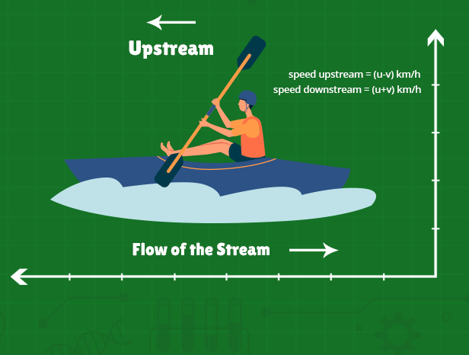
Boats and Streams
General terms:
1) Still water: The water of a river or any other water body which is not flowing is known as still water.
2) Stream: It is the flowing water of a river which is moving at a certain speed.
3) Upstream: The boat or a swimmer moving against the stream is known as moving upstream i.e. against the flow of water.
4) Downstream: The boat or a swimmer moving along the stream is known as moving downstream i.e. along the flow of water.

Slide 22
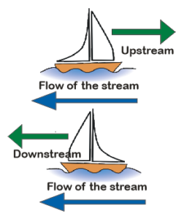
Boats and Streams
Upstream | (u−v) km/hr
Downstream | (u+v)Km/hr
Speed of Boat in Still Water | ½ (Downstream Speed + Upstream Speed)
Speed of Stream | ½ (Downstream Speed – Upstream Speed)

Slide 23
Boats and Streams
1. If the speed of a boat in still water is 15 km/h and the rate of stream is 8 km/h, then find the upstream and downstream speed of the boat?
A]23, 7 B]12.5, 3.5
C]7, 23 D]3.5, 12.5
Notes:
Difficulty level:- Easy (Compulsory)
Option C
Speed of boat=15
Speed of stream=8
Upstream 15-8=7
Downstream=15+8=23

Slide 24
Boats and Streams
2. Ravi can row upstream at 9 km/h and downstream at 15 km/h. Find the Ravi’s speed in still water?
A]12 B]11
C]13 D]14
Notes:
Difficulty level:- Easy (Compulsory)
Option A
Upstream speed= 9
Downstream= 15
Ravi speed in still water= ½(9+15) =12

Slide 25
Boats and Streams
3. A man can row upstream 18 km and 36 km downstream each in 6 hrs. The speed (in kmph) of the current is?
A]2 B]1.5
C]3 D]4
Notes:
Difficulty level:- Easy (Compulsory)
Option B
Upstream speed= 18/6= 3
Downstream speed= 36/6=6
Let speed of boat=x
Speed of stream=y
x-y= 3
x+y=6
By solving y= 1.5

Slide 26
Boats and Streams
4. There are 3 points P, Q and R in a straight line, such that point Q is equidistant from points P and R. A man can swim from point P to R downstream in 48 hours and from Q to P upstream in 32 hours. Find the ratio of speed of man in still water to speed of stream:
A]1:7 B] 7:1
C]5:2 D] 2:5
Notes:
Difficulty level:- Moderate (Compulsory)
Option B

Slide 27
Boats and Streams
5. A boat travels from point A to B, a distance of 12 km. From A it travels 4 km downstream in 15 minutes and the remaining 8 km upstream to reach B. If the downstream speed is four times as high as the upstream speed, what is the average speed of the boat for the journey from A to B?
A] 5.33 km/hr B] 3.33 km/hr
C] 7.33 km/hr D] 9.33 km/hr
Notes:
Difficulty level:- Expert (optional)
Option A
4 km downstream is covered in 15 min.
∴ speed of downstream = 16 km/hr.
So speed of upstream = 4 km/hr. Total time taken for downstream journey = 15 min (given).
Now total time taken for upstream journey = 8/4 = 2 hr = 120 min. Hence total time taken from A to B = 15 + 120 = 135 min. As average speed = Total distance /total time, so average speed from A to B = (12/135)*60 = 5.33 kmph.

Slide 28
Boats and Streams
6. A boat takes 76 hours for travelling downstream from point A to point B and coming back to point C midway between A and B. If the velocity of the stream is 4 kmph and the speed of the boat in still water is 14 kmph, what is the distance between A and B?
A]620 B]520
C] 720 D] 810
Notes:
Difficulty level:- Expert (Compulsory)
Option C

Slide 29
Boats and Streams
7. A boat takes 5 hours for travelling downstream from point A to point B and coming back to point C at 2/3rd of total distance between A and B from point B. If the velocity of the stream is 3 kmph and the speed of the boat in still water is 9 kmph, what is the distance between A and B?
A] 25.7 km B] 24 km
C] 16.4 km D] None
Notes:
Difficulty level:- Expert (Compulsory)
Option A
Let total distance from A to B= d km, So CB = 2d/3 km So d/(9+3) + (2d/3)/(9-3) = 5 Solve, d = 25.7 km

Slide 30
Boats and Streams
8. There are two places A and B which are separated by a distance of 200km. Two boats starts form both the places at the same time towards each other. If one boat is going downstream then the other one is going upstream, if the speed of boat1 and boat2 is 12km/hr. and 13km/hr. respectively. Find at how much time will they meet each other.
A] 10hrs. B] 4 hrs. C] 8hrs. D] 6hrs.
Notes:
Difficulty level:- Expert Compulsory)
Option C
Downstream = (12+x)km/hr Upstream = (13-x)km/hr Time = Distance / Relative speed Relative speed = 12 + x + 13 – x = 25 km/hr Time = 200/25 = 8 hours

Slide 31
Boats and Streams
9. A man travels by a motor boat down a river to his office and back. With the speed of the river unchanged, if he doubles the speed of his motor boat, then his total travel time gets reduced by 50%. The ratio of the original speed of the motor boat to the speed of the river is:
A] √6 : √2 B] 3:2
C] √7: √2 D] None of these
Notes:
Difficulty level:- Expert (optional)
Option D

Slide 32
Data Sufficiency: Boats and Streams
10. What is the speed of the stream, if the ratio of the speed of the boat to stream is 3: 1?
I: A boat covers 30 km in 6 hours upstream.
II: The boat covers 30 km in 3 hours downstream.
A. I alone sufficient while II alone not sufficient to answer
B. II alone sufficient while I alone not sufficient to answer
C. Either I or II alone sufficient to answer
D. Both I and II are not sufficient to answer
E. Both I and II are necessary to answer
Notes:
Difficulty level:- Moderate (Compulsory)
Option C

Slide 33
Data Sufficiency: Boats and Streams
11. What is the speed of the stream? I) The boat covers 45 kms in 5 hours moving downstream. II) The boat covers 42 kms in 7 hours moving upstream. III) The ratio of the speeds of the stream and the boat is 1:5 respectively.
A. Any two of the three
B.1 and 2 only
C. 2 and 3 only
D. 1 and 3 only
E. All 1, 2 and 3
Notes:
Difficulty level:- Expert (optional)
Option A

Slide 34
Any Doubts

